Slide 1
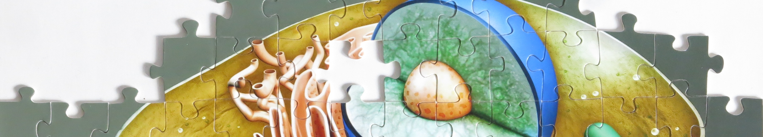

Custom Analysis with oxDNA Analysis Tools
Erik Poppleton
@Floppleton.bsky.social
Postdoc
Biophysical Engineering, Kerstin Göpfrich // Molecular Biomechanics, Frauke Gräter
Max Planck Institute for Medical Research, Heidelberg University // Heidelberg Institute for Theoretical Studies
Heidelberg, Germany

Slide 2
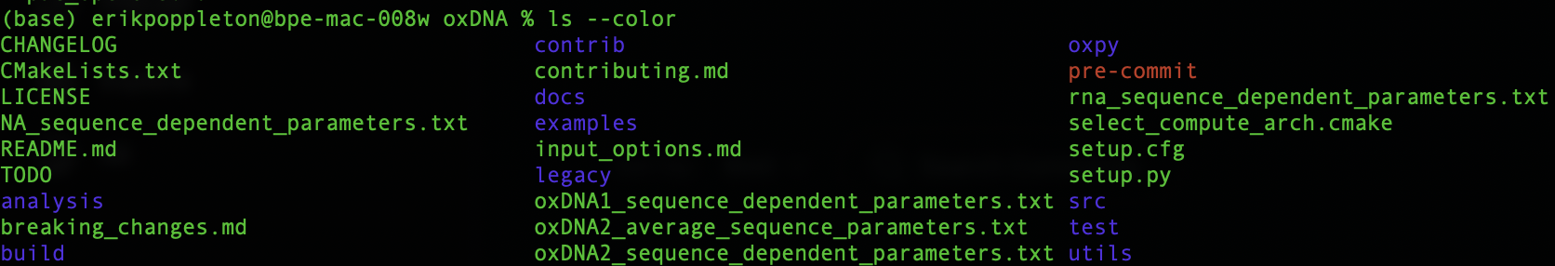
Where do I find OAT and how do I use it?
Right here!
Installation with oxDNA
cd oxDNA
mkdir build
cd build
cmake -DPython .. # Also compile oxpy
make -j4
make install # Install oxpy and oat
Standalone installation
cd oxDNA
python –m pip install ./analysis
oat config # Checks installation
Command Line
oat mean -p6 trajectory.dat
Python scripts
from oxDNA_analysis_tools.mean import mean
mean_conf = mean(traj_info, top_info, ncpus=6)

Slide 3
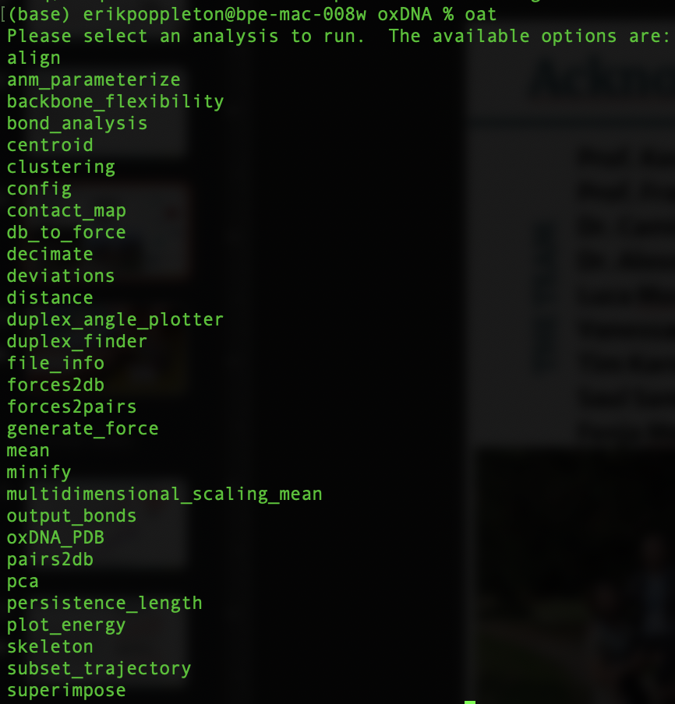
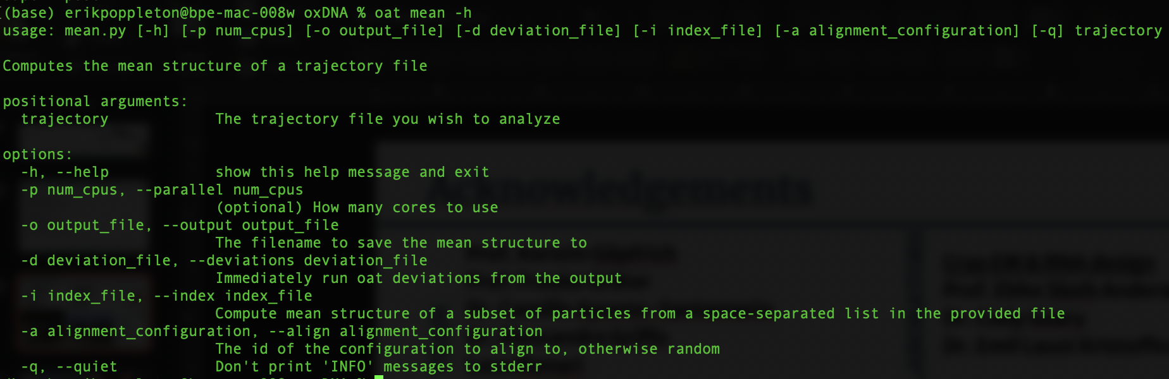
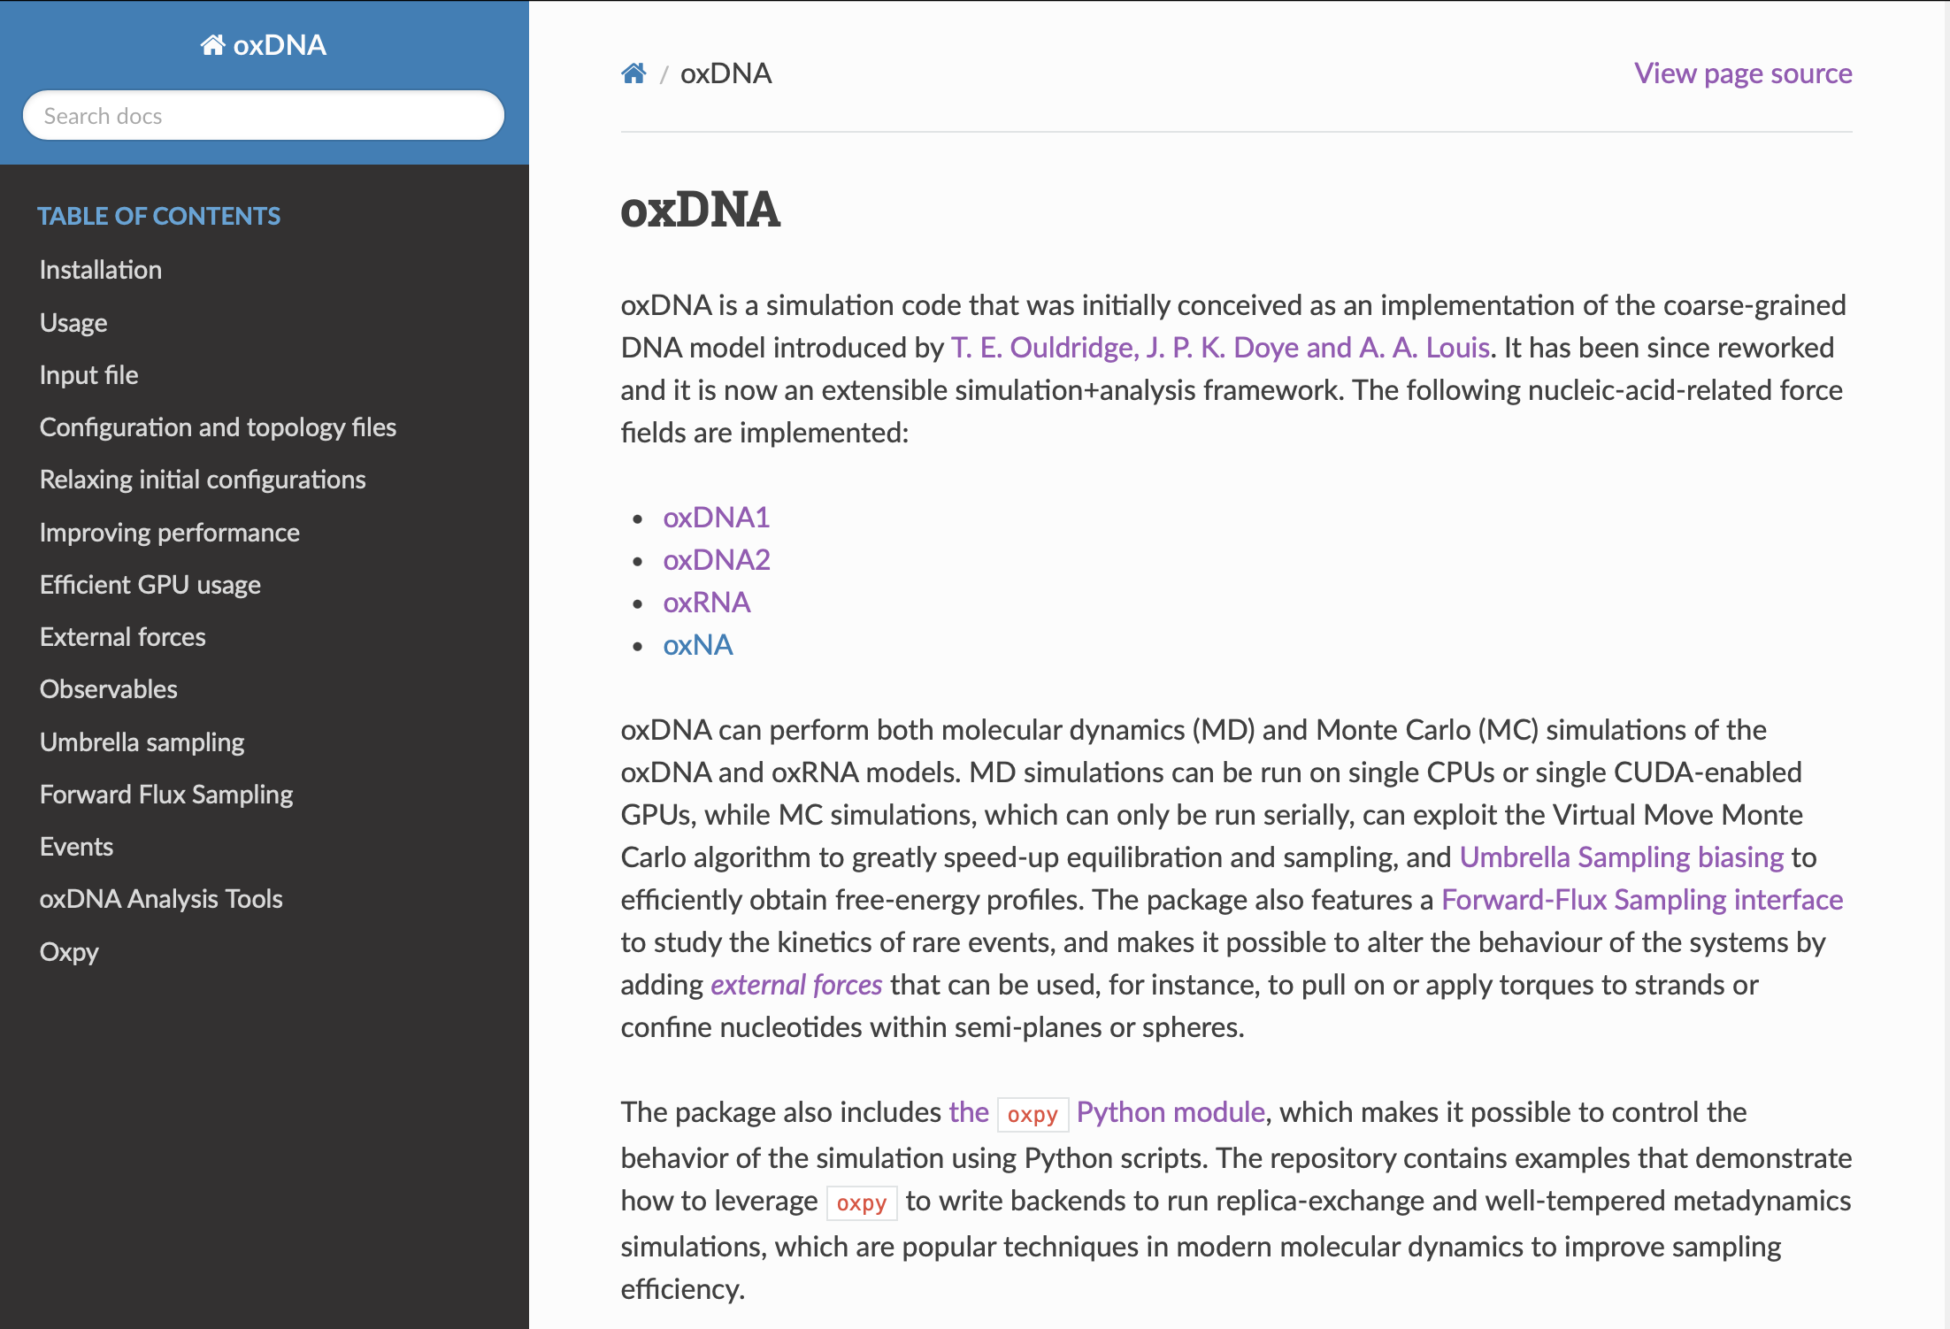
What’s in OAT? What are the arguments?
2. OAT <script> -h Prints help
1. OAT with no arguments
Right here!
3. The documentation!

Slide 4
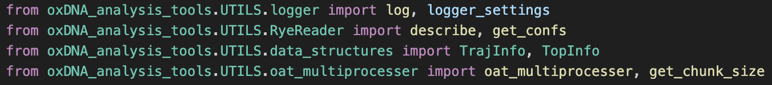
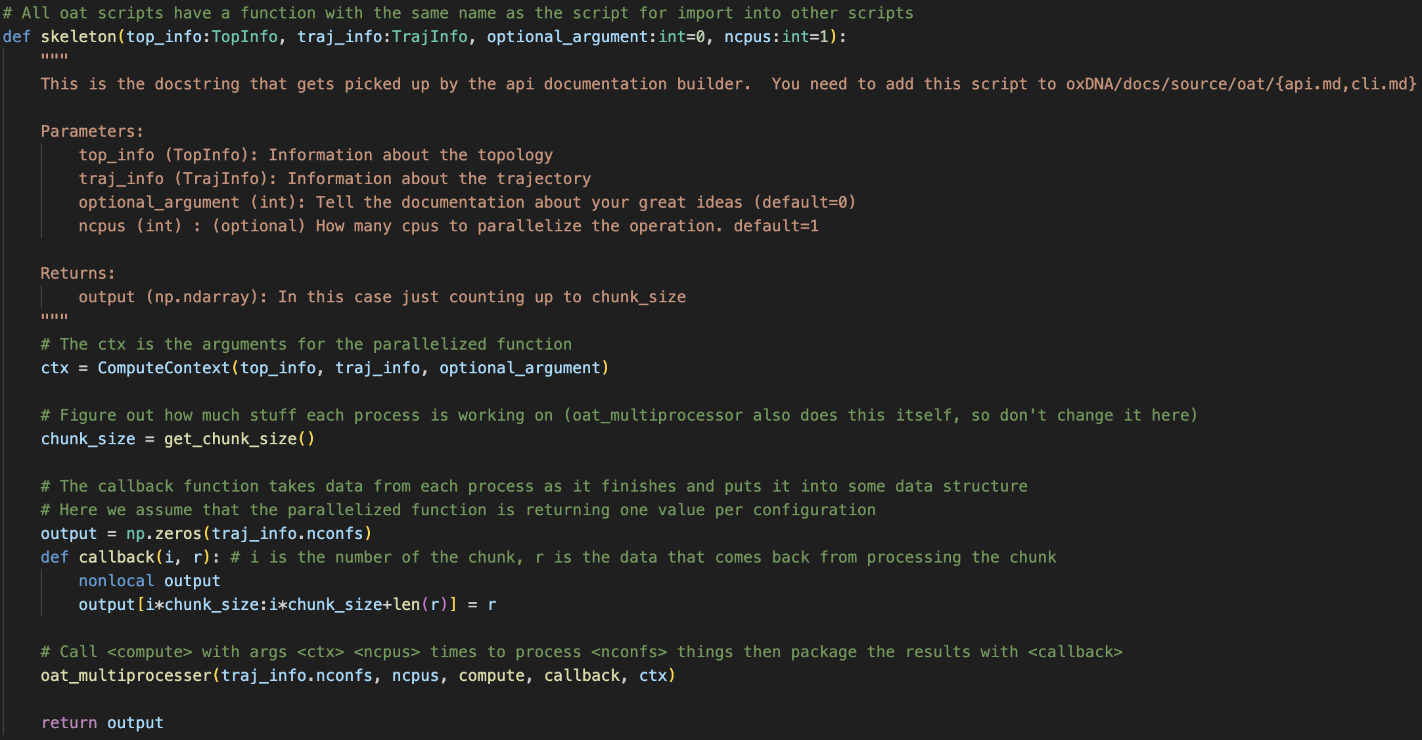
How do I write my own analyses?
Logging
Loading trajectories
Just for type annotations
Parallelize analysis
1. These are your key functions
Examples
mean.py – Commented in detail
bond_analysis.py – How to oxpy
skeleton.py – Trajectory analysis
2. The core of all oat scripts looks like this

Slide 5




oxDNA_analysis_tools.UTILS.RyeReader
RyeReader.describe
Extract metadata from (topology)/trajectory
TopInfo ➡ file path, # of bases
TrajInfo ➡ file path, # of confs, byte positions of confs, velocities in confs?
If you want to skip confs, can [start:stop:stride] the position list
top.top
traj.dat
RyeReader.strand_describe
Extract information from topology
Produces an oxView-style System/elements data structure
System ➡ Strands ➡ Monomers
Elements ➡ Monomers
(strand_)describe
Oat_multiprocessor
RyeReader.get_confs
Random access trajectory reader
Uses the TopInfo/TrajInfo from describe
Wrapper around a C library for maximum performance
Python’s file reading suuuuuuuuucks
get_confs + analysis
RyeReader.inbox
Bring the configuration in the box
For most geometry-based analyses, you need this
fix_diffusion
Cool science

Slide 6
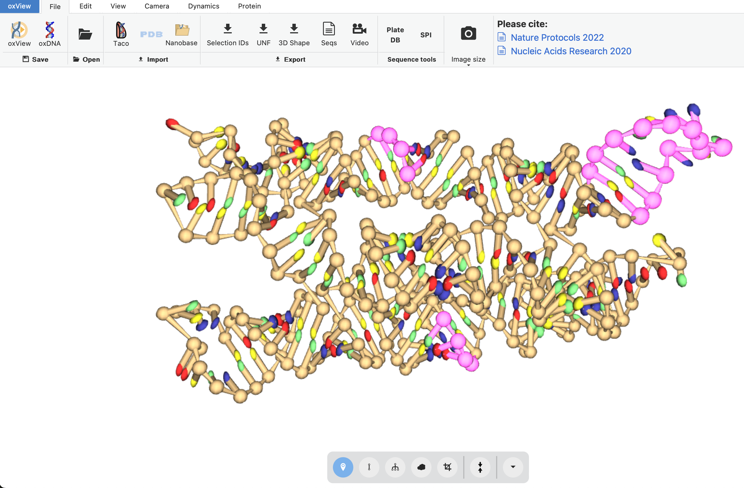
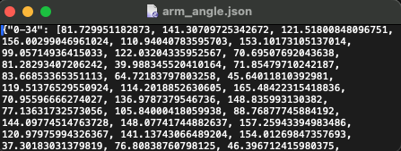
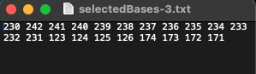
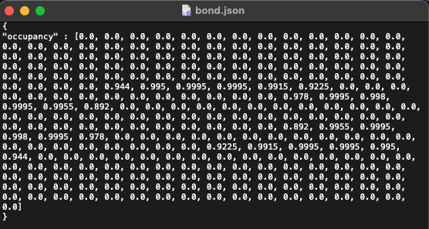
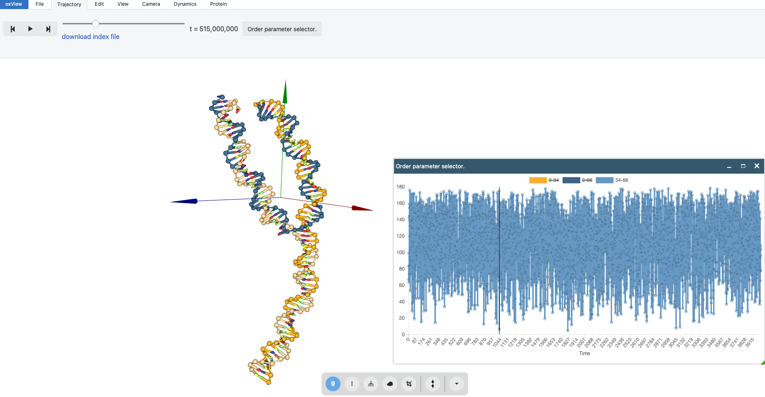
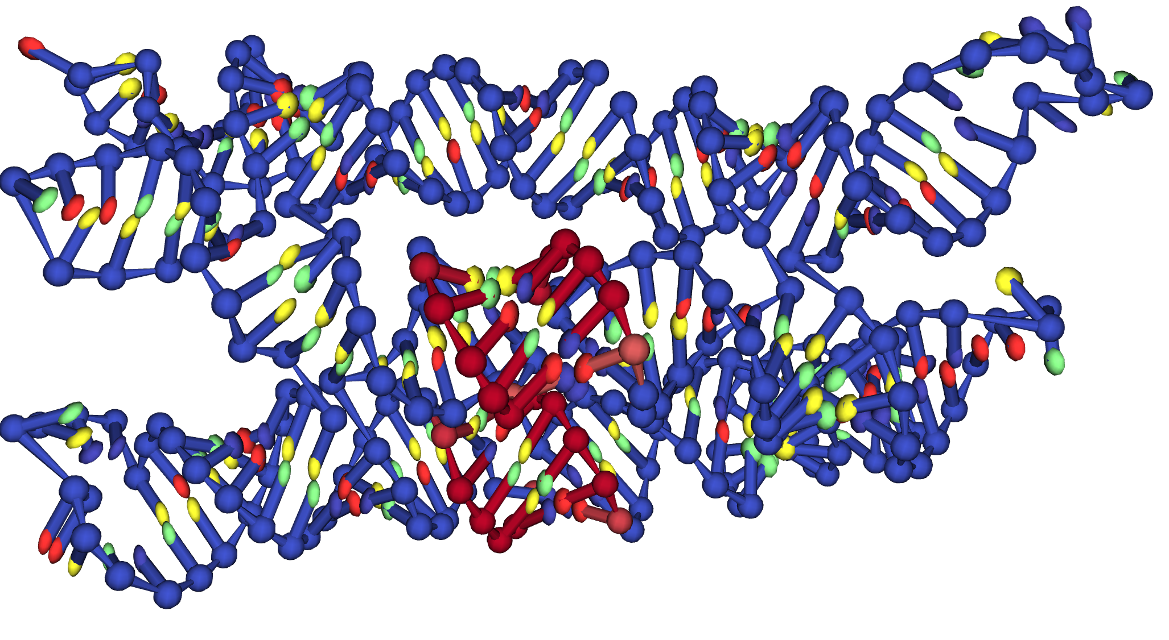
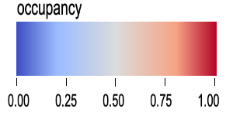
Some useful auxiliary file types
“Index file” (used by align, mean, et. al.)
1-value-per-conf in a json file
Selected bases in oxView
oxView color overlay
oxView trajectory picker
1-value-per-nucleotide in a json file

Slide 7
Let’s code something!

Slide 8




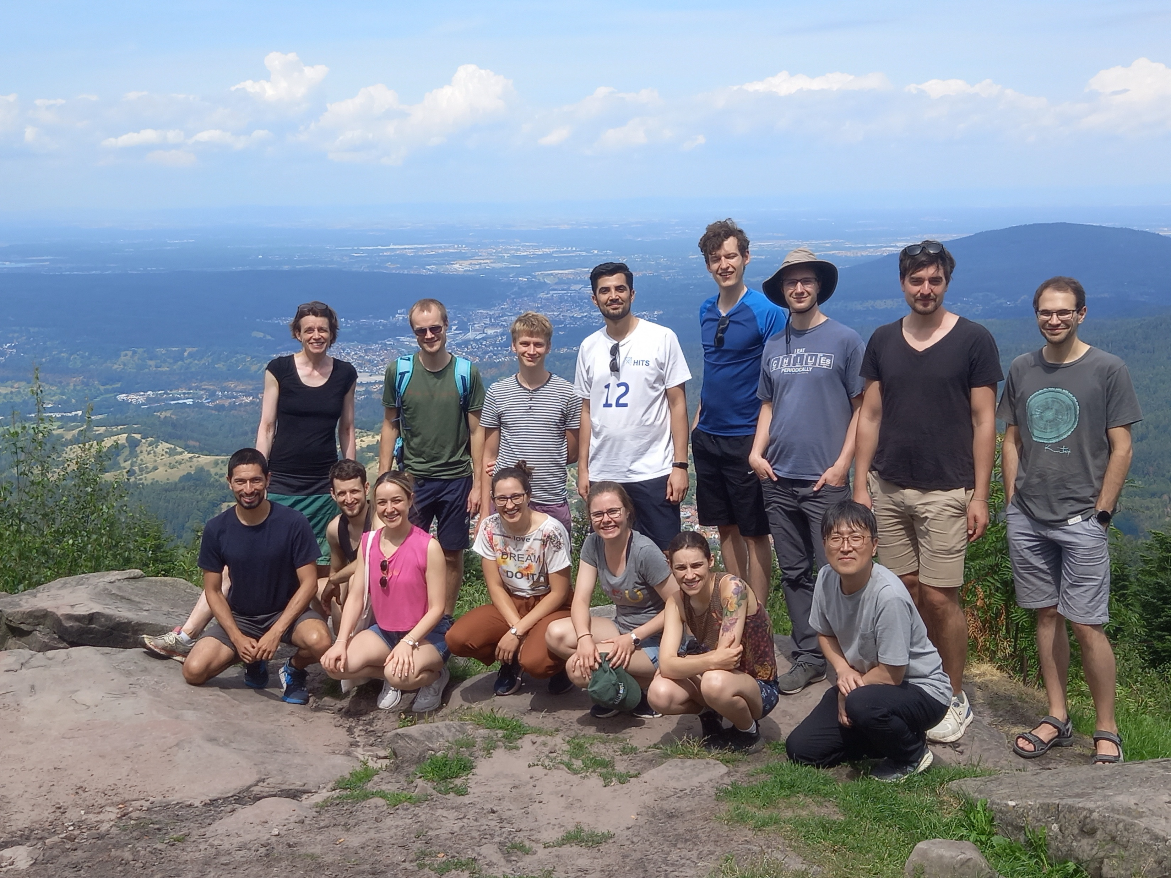




Acknowledgements
Prof. Lorenzo Rovigatti
Dr. Michael Matthies
Prof. Petr Šulc
All our issue openers and pull requesters
Mai Tran
Luca Monari
oxDNA Maintainers
Local Users
OUR FUNDING
@Floppleton.bsky.social
FIND ME ONLINE
github.com/ErikPoppleton
Erik Poppleton
Biophysical Engineering of Life
Molecular Biomechanics
Notes:
Our funding: Please edit as appropriate!

Slide 9
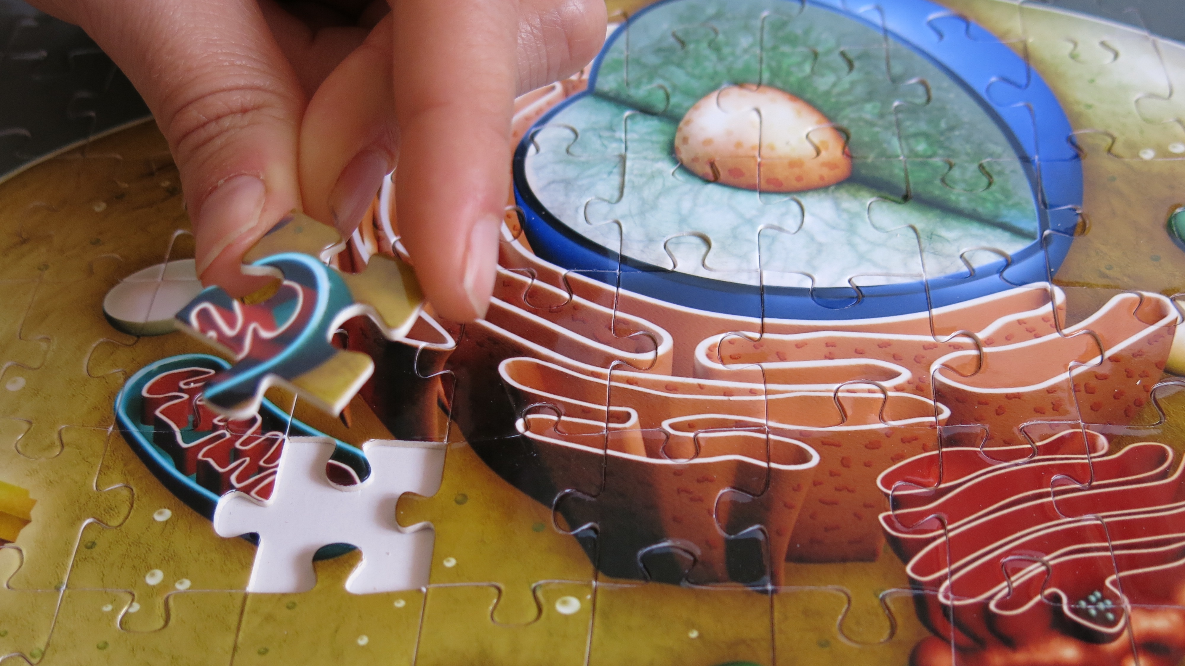
Thank you!

